Slide 1

PRE-CLOSE
DATA SHARING
RULES

Slide 2
Integration leads require additional data to create integration plans
Acquirer and Acquired Co. legal teams determine if the data requested is
Non-Sensitive: OK for integration team to review
Data is placed into a Virtual Data Room (VDR)
Integration Team folder, for Non-Sensitive data
Work streams request data to be “harvested”
Sensitive: giving a business a competitive advantage or inﬂuence
Clean Team folder and Legal Only folder for Sensitive data
The Process
All requests are considered and data is retrieved, if possible
As we get near to closing the deal, data will get declassiﬁed
© 100-Day Advisors MandAPlaybook.com
02

Slide 3















Finished
Data already in Integration Team area of VDR?
Process Flow
Work Stream requests data using Smartsheet
Placed into Integration Team area of VDR
Legal deﬁnes data as Sensitive?
Acq. Co. Point of Contact
assigned to ﬁnd or create data
No
Data needs to be created. Acquired Co. resource constraints: declines creating data
Yes
Escalation process
Acquirer team escalates
issue?
Yes
Places into VDR, Clean Team folder for later access
If belongs in VDR, Acquired Co. Point of Contact assigned to ﬁnd data
Places into VDR, Legal Only folder for Day 1 access
© 100-Day Advisors MandAPlaybook.com
03

Slide 4

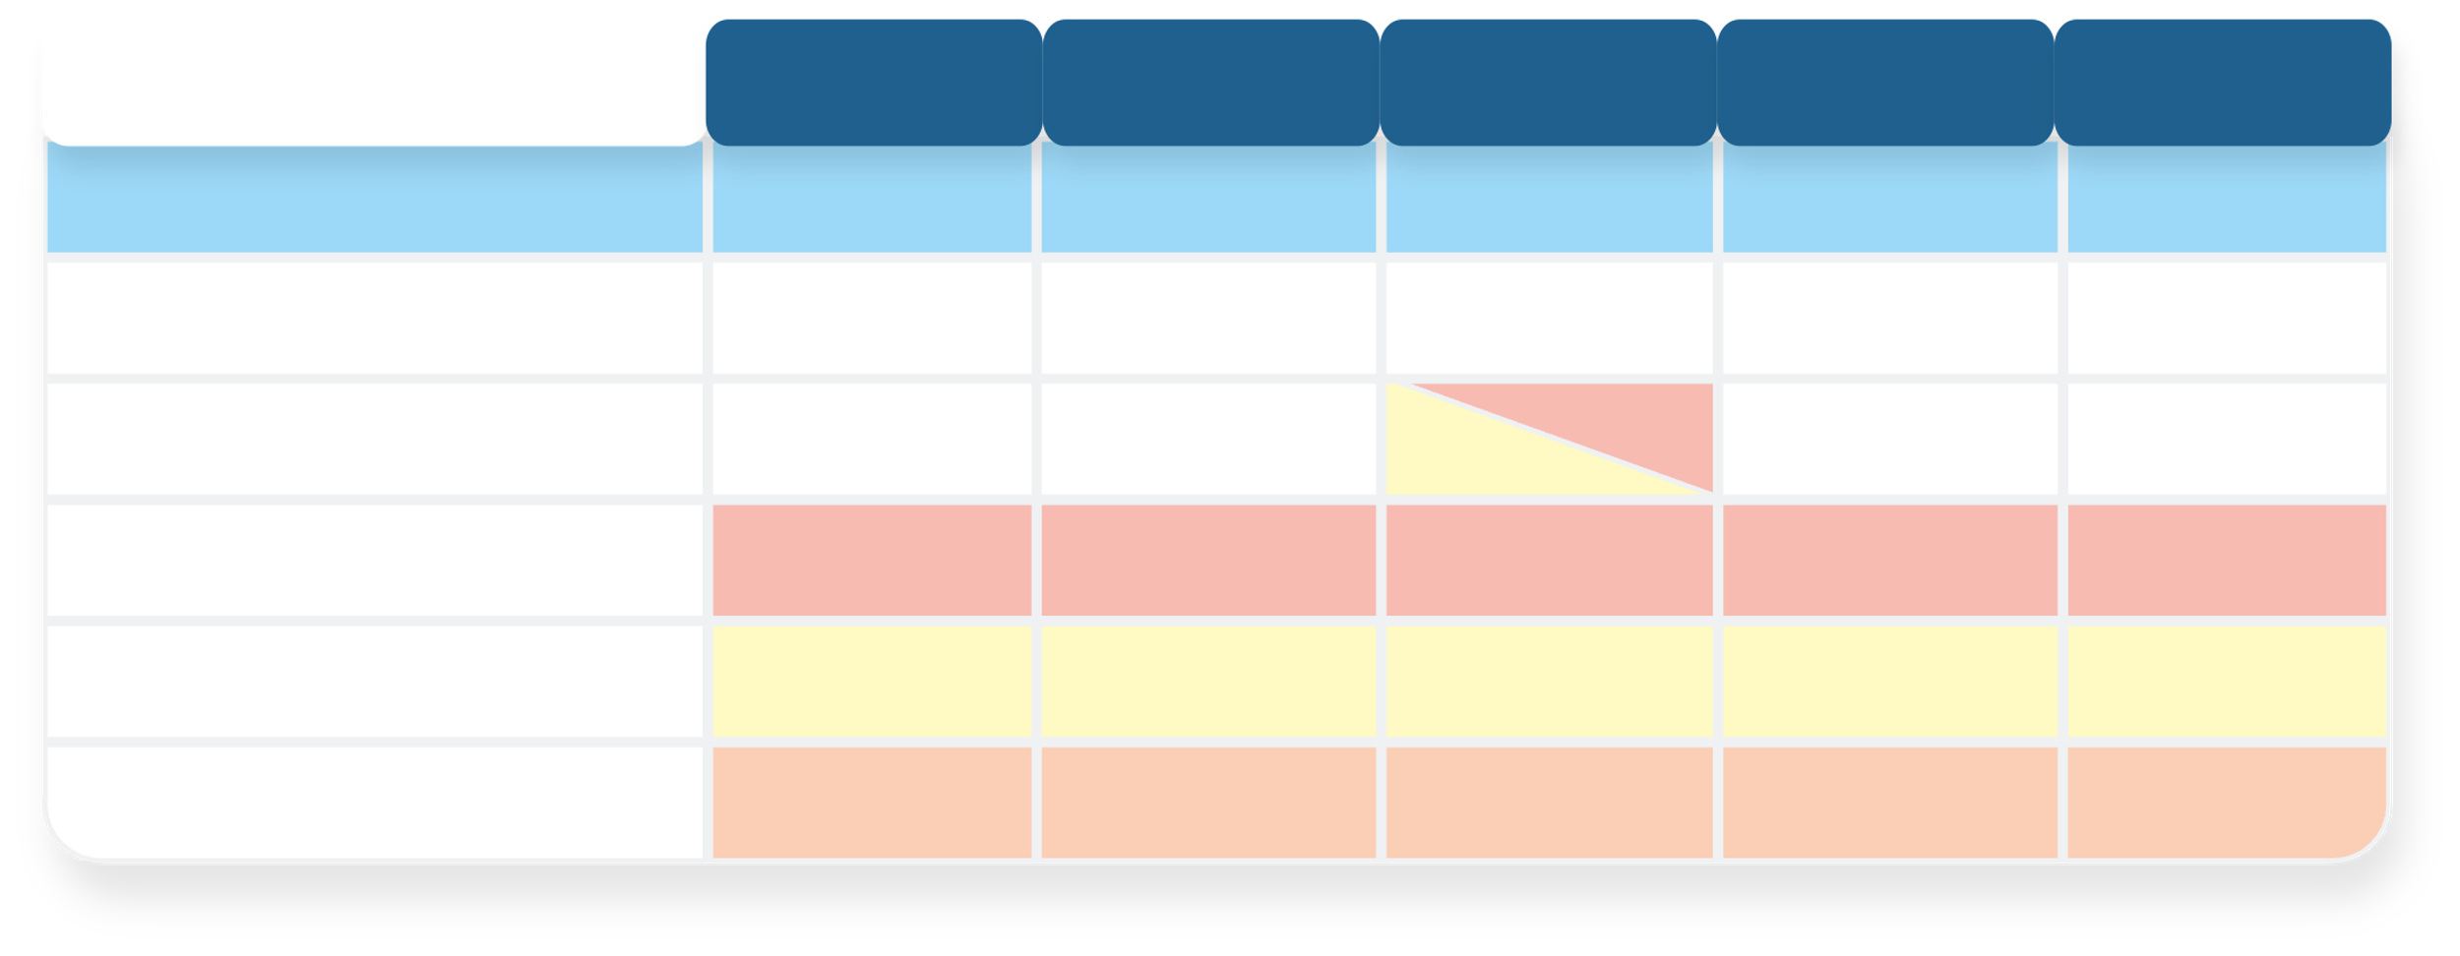
Weekly Data Harvesting Meetings
Legal & IMO will review requests and approve
IMO holds weekly meeting with Legal teams to review data requests
Mon
Tues
Wed
Thur
Fri
KEY EVENTS
Team Leads submit requests
IMO meeting w/Legal
Legal reviews requests
Acquired Co. responses
IMO monitors responses
Slated for Wednesdays
Submit your requests by Tuesday close of business to be considered in this meeting
© 100-Day Advisors MandAPlaybook.com
05

Slide 5
Escalation Scenarios
Declared “Sensitive” by Acquired Co.
Mitigation Steps:
1. LEGAL TEAM TO SIGN OFF REQUEST
Store data responses in a ﬁle
^{2. REQUEST MEETING TO RESOLVE}
Data Needs to be Created By Acquired Co.
DEPENDING UPON THE CRITICALITY, TEAM MAY
Clarify the importance
“Horse Trade” other requests to create bandwidth
Legal team to agree on agenda in advance
3. ESCALATE TO INTEGRATION MANAGER
^{4. ESCALATE TO EVP}
© 100-Day Advisors MandAPlaybook.com
06

Slide 6

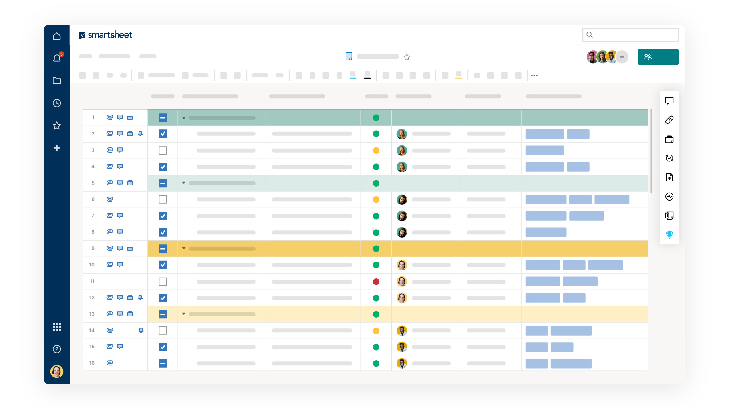



Escalation 1: Ask Speciﬁc Questions
If you are not given access to a document
Because some of the content is sensitive, ask speciﬁc questions that you want answered
Questions should be
written in a Word document
Create a new request in the Data Request Smartsheet
In Detailed Description ﬁeld add the text “See attached ﬁle”
Add the ﬁle to that row
© 100-Day Advisors MandAPlaybook.com
07

Slide 7

Escalation 2: Meeting Request
Request meeting in Smartsheet
Must include meeting agenda
IMO and Legal approve the meeting
Stick to the agreed agenda
Be aware of HSR restrictions
Attach a ﬁle with the agenda to the row that has the request
© 100-Day Advisors MandAPlaybook.com
08

Slide 8
General FAQs
Q1
What is considered Sensitive Data?
Generally, it is information that can affect the business of Acquired Co. if the acquisition were to not take place
Q2
What do I do if someone emails me the data?
This is a violation of HRC rules
Copy and paste the email into a Word document
Place it into your xyz folder
Reply to the email to tell the contact what you’ve done
What if I have issues accessing Smartsheet or xyz?
Contact 100-Day Advisors
Q3
© 100-Day Advisors MandAPlaybook.com
09

Slide 9
Acquired Co. - Speciﬁc FAQs
Q4
How do the Acquired Co. staff know who or where to send their data to?
Send to Point Of Contact (POC) - the
Acquired Co. team has access
Q5
What if only part of the data is available?
Give what you can ASAP, with a readme doc that explains why only part is available
© 100-Day Advisors MandAPlaybook.com
10

Slide 10



Email: inquiries@ MandAPlaybook.com
Website: MandAPlaybook.com
© 100-Day Advisors MandAPlaybook.com
11

